Slide 1



CORPORATE OVERVIEW
Capital Readiness & Strategic Advisory
For founder-led growth companies, family offices, investors and corporate strategy teams.
Readiness before outreach. Fit before forwarding. Governance before scale.
Clean XITIJ-branded corporate collateral | v1.1 | Refreshed logo

Slide 2

THE XITIJ THESIS
Funding is not validation.
Capital should accelerate clarity — not compensate for its absence.
Many good businesses are not yet fundable.
Investor conversations often expose gaps that should have been fixed earlier.
The right capital source depends on stage, evidence, ownership goals and transaction logic.
Readiness is a deliberate operating discipline — not a last-mile fundraising activity.
Readiness → Fit → Capital
Evidence over optimism
Core belief
Operating lens
XITIJ Services | Capital Readiness • Strategic Advisory • Investment Facilitation
02

Slide 3

DEFINITION
What XITIJ does
A readiness-led advisory platform between ambition, capital and execution.
XITIJ helps startups and growth-stage businesses become capital-ready, investor-ready and transaction-ready.
Fundability diagnostics, capital-fit analysis and investor narrative refinement.
Financial model, data-room, governance and diligence-readiness support.
Investment facilitation, strategic growth advisory and expert-bench access.
Not a broker
Not generic consulting
Readiness-led advisory
XITIJ Services | Capital Readiness • Strategic Advisory • Investment Facilitation
03

Slide 4

MARKET CONTEXT
Why XITIJ is relevant now
The capital environment increasingly rewards proof, governance and disciplined execution.
Capital is selective
Investors expect sharper stage-fit, traction quality and risk visibility.
Founders need preparation
A rushed pitch can permanently damage high-value investor relationships.
Governance starts early
Data rooms, MIS, compliance and cap tables are credibility signals.
Strategic capital is nuanced
Family offices, corporates and angels need context — not just deal flow.
XITIJ Services | Capital Readiness • Strategic Advisory • Investment Facilitation
04

Slide 5
ADVISORY ARCHITECTURE
One platform. Four connected advisory routes.
XITIJ structures conversations where capital, strategy and senior operating expertise intersect.
Capital Readiness
Strategic Growth
Fundability, investor narrative, model, data room and governance.
GTM, partnerships, venture-building, execution cadence and PMO.
readiness-led value creation
Investment Facilitation
Expert Bench
Capital-fit, qualified context and investor/family-office conversations.
Virtual CXO mandates and senior operating support for specific gaps.
XITIJ Services | Capital Readiness • Strategic Advisory • Investment Facilitation
05

Slide 6
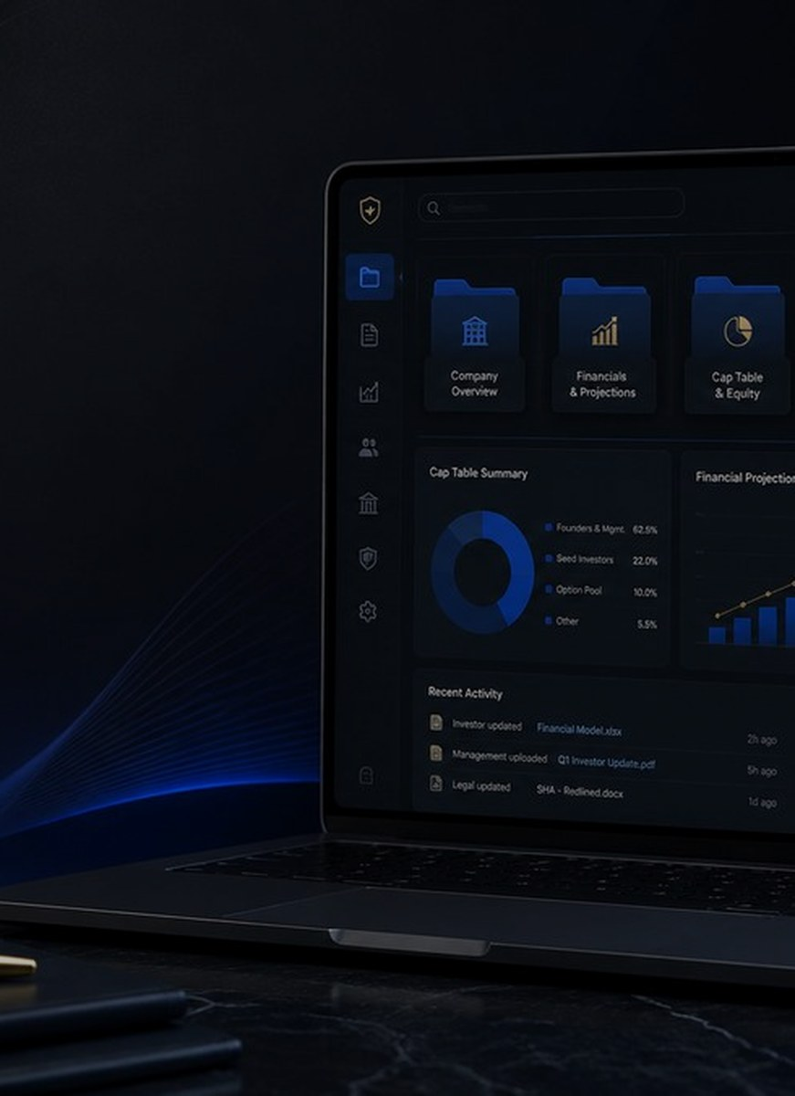
VALUE CHAIN
How XITIJ creates value
The model improves decision quality before high-stakes conversations begin.
1
2
3
4
5
Diagnose
Prepare
Match
Protect
Govern
fundability gaps
investor artifacts
capital with stage
ownership discipline
execution rhythm
Output: a clearer capital story, stronger diligence posture and better conversations with serious stakeholders.
XITIJ Services | Capital Readiness • Strategic Advisory • Investment Facilitation
06

Slide 7
OPERATING JOURNEY
The XITIJ engagement model
From advisory conversation to governed execution.
Mandates are designed as decision systems — not one-off consulting memos.
1
2
3
4
5
6
Orient
Diagnose
Design
Prepare
Facilitate
Govern
Clarify ambition and context.
Assess capital, GTM and governance gaps.
Define mandate and success signals.
Create/refine deck, model, data room and MIS.
Open relevant stakeholder conversations.
Track actions, risks and decisions.
XITIJ Services | Capital Readiness • Strategic Advisory • Investment Facilitation
07

Slide 8

FOUNDER LENS
For founders raising capital
Become investor-ready before you start investor outreach.
XITIJ prepares founders for serious investor conversations.
Fundability diagnostic: surface the questions investors will ask.
Investor narrative: turn founder conviction into a forwardable story.
Data-room readiness: reduce friction and improve diligence confidence.
Capital-fit: choose the right route — angel, family office, VC, debt, strategic or customer-funded growth.
Core outcome: fewer wasted meetings, clearer asks and better ownership discipline.
XITIJ Services | Capital Readiness • Strategic Advisory • Investment Facilitation
08

Slide 9
INVESTOR LENS
For family offices and investors
See better-prepared opportunities — and evaluate them with stronger context.
XITIJ is not a volume-led deal-pushing mechanism.
Founder preparedness before capital conversations.
Diligence signals around revenue quality, governance, cap table and data-room maturity.
Context on sector, stage, instrument, ticket size and strategic relevance.
No substitute for independent diligence; better input for informed decision-making.
XITIJ Services | Capital Readiness • Strategic Advisory • Investment Facilitation
09

Slide 10

CORPORATE LENS
For corporate strategy teams
Turn startup engagement into structured strategic value.
Startup partnerships fail when enthusiasm outruns diligence.
Clarify strategic fit, problem alignment and adoption pathways.
Assess partnership logic, startup-fit and operating compatibility.
Review transaction readiness: contracts, data room, revenue quality and governance.
Support post-commitment governance and review cadence.
XITIJ Services | Capital Readiness • Strategic Advisory • Investment Facilitation
10

Slide 11

OPERATING EXPERTISE
Expert Bench & Virtual CXO support
Senior leadership capacity for specific mandates — without permanent hiring friction.
Where advice has to become operating rhythm.
CFO
cash, runway, fundability
COO
execution, cadence, productivity
CRO/CMO
revenue architecture, GTM
CDO/CIO
AI, data, digital roadmap
Chief of Staff
founder leverage, governance
Typical fit: 90-day structured mandates with clear deliverables, cadence and reviewable work products.
XITIJ Services | Capital Readiness • Strategic Advisory • Investment Facilitation
11

Slide 12
SECTOR CONTEXTS
Industry fit: the trigger matters more than the label
XITIJ is strongest when ambition has outgrown the current operating system.
Startups & Growth Ventures
BPO, BPM & Customer Operations
seed, angel, strategic or institutional readiness
productivity, automation, CX and workforce effectiveness
AI, SaaS & Digital Platforms
Manufacturing & Industrial Services
enterprise proof, repeatable GTM, adoption evidence
working-capital discipline and operational visibility
BFSI, Fintech & Collections
Family Businesses & SMEs
governance, compliance, data and operating control
professionalization without losing promoter agility
Core XITIJ lens: fundability + governance + execution cadence + strategic value creation.
XITIJ Services | Capital Readiness • Strategic Advisory • Investment Facilitation
12

Slide 13
TRUST & PROOF
Engagement patterns and case notes
Representative, anonymised narratives that show XITIJ’s diagnostic and operating lens.
01
Family business governance
Founder-centric reviews → board-level cadence
02
BFSI collections BPO
Transformation initiatives → PMO and control rhythm
03
SaaS GTM readiness
Founder-led selling → revenue operating system
04
Manufacturing control tower
Demand strength → cash and operations visibility
05
AI & data governance
Pilots → ownership, risk and benefit tracking
Case notes are illustrative patterns. They do not disclose confidential client information or promise identical outcomes.
XITIJ Services | Capital Readiness • Strategic Advisory • Investment Facilitation
13

Slide 14

TOOLS
Resource Centre & founder tools
Convert intent into structured readiness actions.
Practical assets for internal sharing, qualification and first conversations.
Fundability assessment and founder readiness diagnostic.
Capital readiness guides: pitch, data room, governance, capital fit and exits.
Investor/co-invest route and partner collaboration pathway.
Expert Bench programme for senior professionals and operating mandates.
XITIJ Services | Capital Readiness • Strategic Advisory • Investment Facilitation
14

Slide 15
CALL TO ACTION
How engagement begins
Start with the route that matches the stakeholder context.
Founder Readiness Review
Investor / Family Office Route
Partner / Expert Bench Route
For startups and SMEs preparing for capital, strategic growth or governance maturity.
For investors seeking better-prepared conversations and readiness-led deal context.
For ecosystem partners, senior CXOs and advisors with mandate-fit capabilities.
Assess Fundability
Co-Invest with XITIJ
Partner with XITIJ
Every route is designed to clarify fit before expanding time, reputation or capital at risk.
XITIJ Services | Capital Readiness • Strategic Advisory • Investment Facilitation
15

Slide 16

NEXT CONVERSATION
Become ready before the market tests you.
XITIJ Services
info@xitijservices.com | +91-9130835165
https://xitijservices.com
Disclaimer: This presentation is informational and does not constitute investment, legal, tax or financial advice, an offer, solicitation or recommendation. Engagements and outcomes are context-specific and subject to independent diligence and professional advice.

